Slide 1
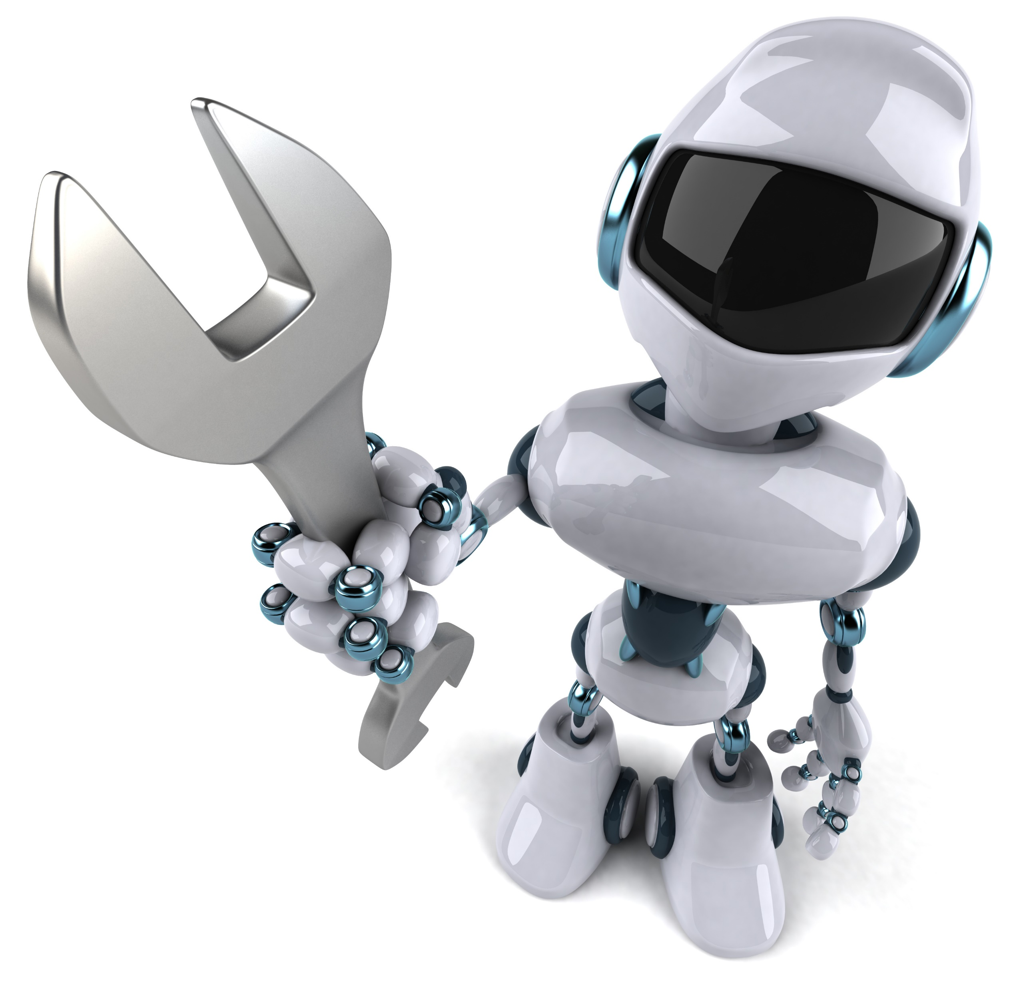
Introduction to Robotics
Rimvydas Rubavicius

Slide 2
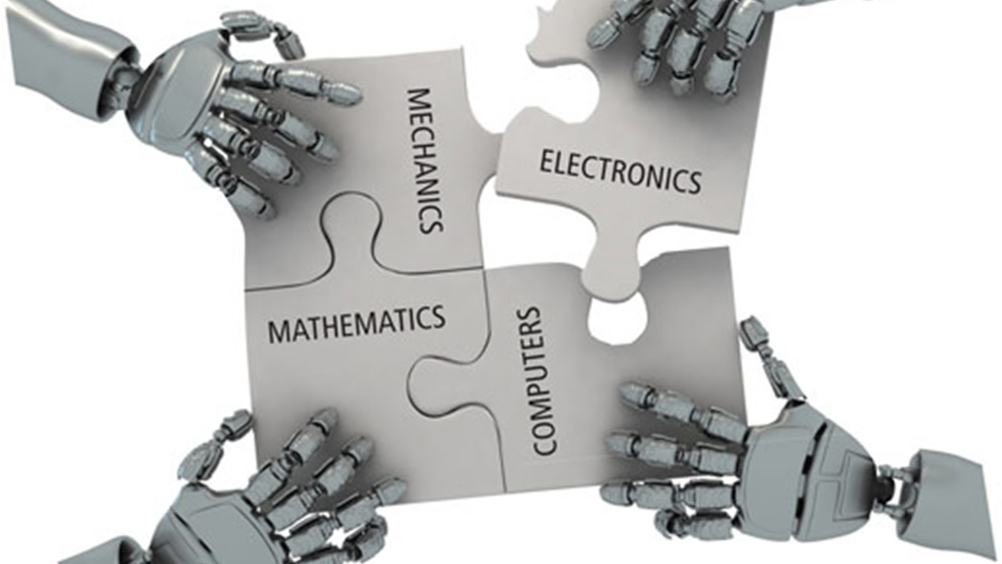
Elements of Robotics

Slide 3
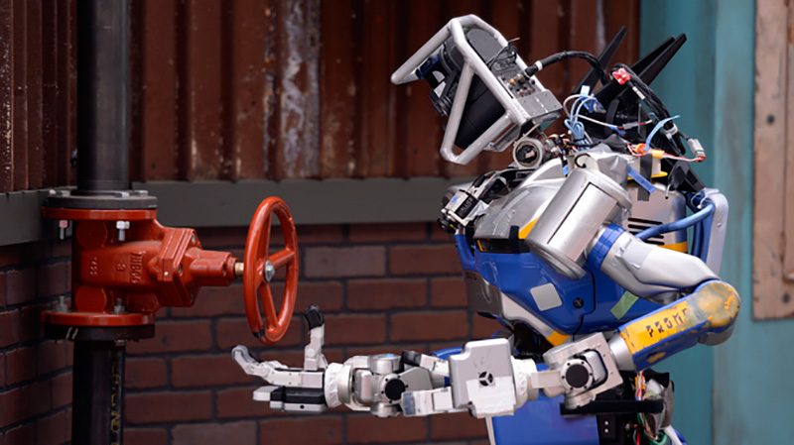
Why robotics is still hard?

Slide 4

DARPA Robotics Challenge

Slide 5
Sensing; RoboCup German Open 2015

Slide 6
Manipulation; Shadow Hand

Slide 7
Complex environment

Slide 8
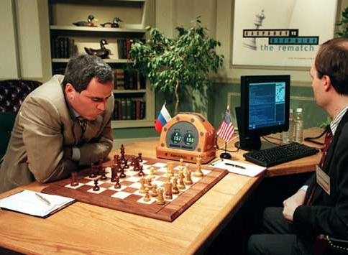
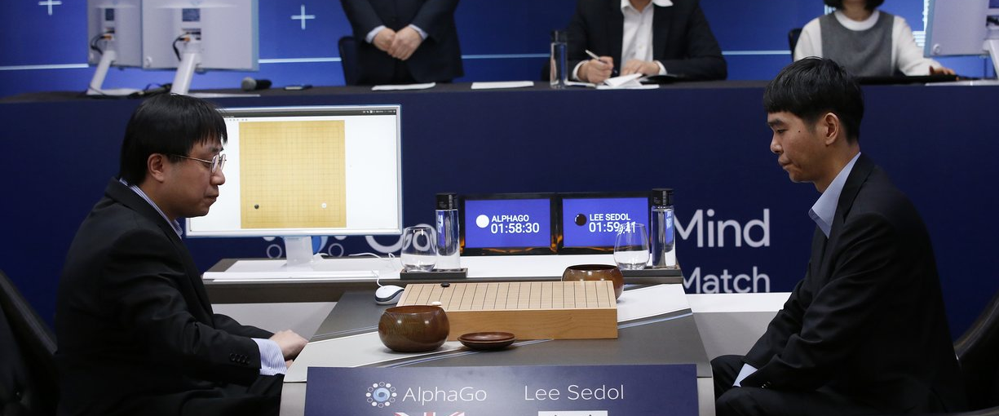
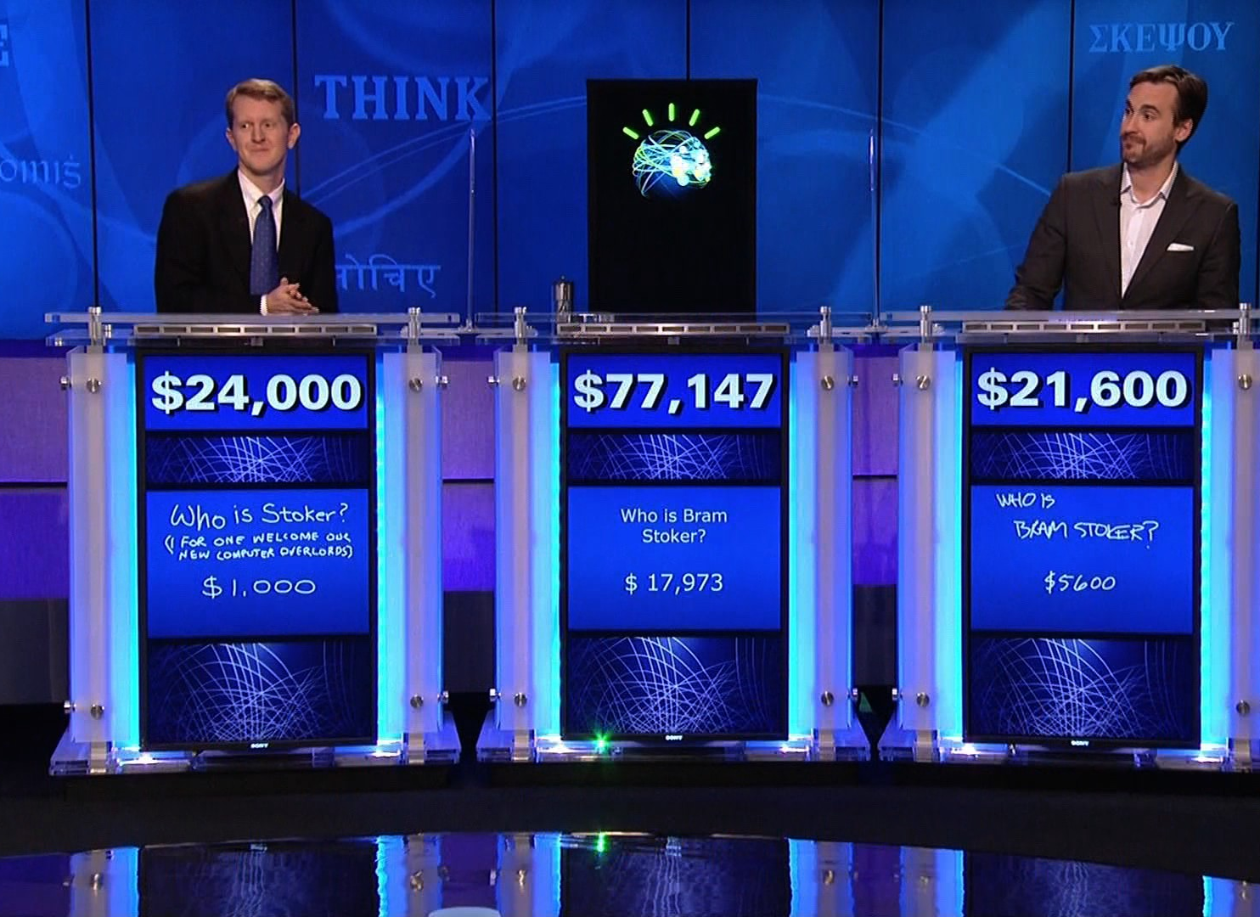
Computer intelligence

Slide 9
IBM Watson Heath

Slide 10

Edinburgh centre of robotics

